Slide 1
Itemized Deductions
Pub 4012 – Tab F
Pub 4491 – Lessons 20 & 21
Notes:
1
Instructor note: This presentation contains a large number of slides detailing the various allowable deductions. Instructors may choose to direct volunteers to the Interview Tips in Pub 4012 Tab F to review these deductions.

Slide 2
Lesson Topics
Itemized Deductions
Medical expenses
Deductible and nondeductible taxes
Mortgage interest
Charitable contributions
Miscellaneous deductions
State only: miscellaneous deductions subject to 2% limitation

Slide 3
Deductions
May claim larger of
Standard deduction
Increased if at least 65 or blind
OR
Itemized deductions
If itemized deductions are entered, software selects better option
Notes:
Stress to enter all itemized deductions if your state has a lower threshold

Slide 4
Married Filing Separately
If taxpayer files MFS and spouse itemizes deductions
Taxpayer must itemize OR
Take a standard deduction of ZERO
If taxpayer files MFS with standard deduction and spouse then files MFS with itemized deduction, taxpayer must amend return

Slide 5
Intake/Interview
Verify taxable income after standard deduction before itemizing
State return may benefit from itemized deductions

Slide 6
Possible Itemized Deductions
Medical or dental expenses
Taxes
Interest
Gifts to charity
Casualty and theft losses – out of scope
Miscellaneous deductions

Slide 7
Limitations on Scope
Scope Manual
Refer individuals with the following to paid preparer
Investment interest expense, e.g. margin interest on brokerage statement
Charitable contribution carryover from a prior year
or created in the current year
Noncash donations exceeding $5,000
Vehicle donation exceeding $500
Casualties or theft losses

Slide 8
Medical Expenses
Pub 4012 Tab F
Medical expenses include
Diagnosis, cure, mitigation, treatment, or prevention of disease
Treatments affecting any part or function of body
Equipment, supplies, and diagnostic devices
Premiums for insurance that covers medical care
Long-term care insurance premiums (limited)
Transportation/travel to get medical care
Home improvements needed for mobility or medical care
Find list of items included or not included in Pub 4012, Tab F

Slide 9
Medical Expenses
Not all “medical” expenses qualify
Examples of not qualified expenses:
Cosmetic surgery
Funeral or burial expenses
Nonprescription drugs, except insulin or over-the-counter drugs with prescription
Weight loss program not prescribed
Diet food

Slide 10
Medical Expenses
Must be paid during tax year
Cannot be reimbursed expenses, including reimbursement from a health savings account (HSA)
Only for taxpayer, spouse, or dependents
Can claim medical for individual that would have been a dependent were it not for
Gross income test OR
Taxpayer dependent of another
Parent can claim medical for child even though not claiming child as dependent (rules for divorced or separated parents)

Slide 11
Medical Expenses
2019 medical mileage 20¢ per mile
AGI threshold for medical expenses
10 % 2019
7.5 % 2018 and 2017
10% 2016 and prior (7.5% if over age 65)
Software applies the threshold

Slide 12
Medical Deduction Quiz
Deductible medical expense?
Prescription sunglasses
Contact lenses
Dentist teeth whitening
Gym fee (doctor suggested exercise)
Dentist teeth cleaning
Stop smoking program
Yes
Yes
No
No
Yes
Yes

Slide 13
Deductible Taxes
Must be imposed on taxpayer
Must be paid in current tax year
Schedule A taxes limited to $10,000/$5,000 MFS
Notes:
13
Cap on deductions is new as of 2018

Slide 14
Deductible Taxes
State and local taxes
Income tax
OR
General sales tax
Real estate tax (U.S. only)
Personal property tax based on value
Other taxes
Notes:
14
Starting 2018, foreign property taxes are no longer deductible on Sch A
If the foreign property tax relates to a business or income producing activity, it can be deducted on Schedule C or Schedule E (Schedule E out of scope without Military certification), respectively

Slide 15
State and Local Taxes
Income taxes
Withheld (W-2, Form 1099-R, etc.)
Estimated and prior year state income tax payments
Other local income tax payments
Or
General sales tax (next slide)
Notes:
15

Slide 16
State and Local Taxes
General sales taxes
Use TaxSlayer sales tax worksheet
Increase the calculated MAGI for allowable nontaxable income
See worksheet in NTTC-modified Pub 4012 Tab F
Examples: Life insurance proceeds, inheritance, VA benefits, gifts
Notes:
16

Slide 17
State Sales Tax
Sales tax option – add tax for:
Motor vehicle (car, motorcycle, motor home, off-road vehicle, etc.)
Boat or airplane
Home, home addition or renovation
Capital improvements not home repairs
Sales tax must have been separately stated and paid by taxpayer (not contractor)

Slide 18
Deductible Taxes
Real estate (property) taxes (Ad Valorem)
May be reported by mortgage company on Form 1098
Includes parcel taxes
Not for
Benefit to property (tending to increase value)
Itemized charges for services (such as trash pickup or sewer fees)
Transfer taxes (or stamp taxes)
Various local fees (Non-Ad Valorem)
Homeowners' association charges
Foreign property taxes
Notes:
18

Slide 19
Other Deductible Taxes
Personal property taxes based on value of personal property only
If based on weight and value, only value-based portion is deductible (boat, vehicles, RVs, etc.)
Other taxes
Foreign income taxes, if credit not claimed (Form 1116)
Notes:
19

Slide 20
Nondeductible Taxes
Federal income and excise taxes
Social security or Medicare
Federal unemployment (FUTA)
Railroad retirement taxes (RRTA)
Customs duties
Federal gift taxes
Per capita taxes
Foreign real property taxes
Notes:
20

Slide 21
Home Mortgage Interest Deduction
Interest on “acquisition debt” secured by main home or second home
Mortgage to buy, build, or improve home or second home
Debt must be secured by “the” property
Cannot mortgage main home to buy a vacation home
Total debt must not exceed value of home

Slide 22
Home Mortgage Interest – New Debt
Main or second home debt entered into on or after December 15, 2017
Interest on up to $750,000 ($375,000 MFS) of debt can be deducted
May not exceed value of home

Slide 23
Home Mortgage Interest Deduction
Debt incurred prior to December 15, 2017 is grandfathered
Limited to mortgage interest on debt of up to $1 million ($500,000 MFS)
Same to buy, build or improved criteria
Must be secured by “the” property
Transition rule: home purchased with binding contract on 12/15/17 and completed before 4/1/18
Can refinance the grandfathered debt
Grandfathered limits continue until the end of the original debt term for the old debt amount; then, new limits apply

Slide 24
Home Equity Debt
Tax years 2018 – 2025 deduction for interest is removed on home equity debt
Can qualify as acquisition debt if used to buy, build or improve the main or second home and secured by such property, subject to applicable debt limit
Can no longer deduct interest if used for other purposes (e.g. college expenses, vehicle purchase, credit card debt consolidation, etc.)

Slide 25
Private Mortgage Insurance (PMI)
Qualified mortgage insurance is no longer deductible as interest
PMI deduction expired 12/31/17
Can be used for prior year returns

Slide 26
Reverse Mortgages
Interest is paid when the mortgage is settled
When paid, subject to the normal deduction limits
Debt proceeds not used to buy, build, or improve home –interest not deductible
If reverse mortgage refinanced qualified acquisition debt, part of the interest may be deducted when paid

Slide 27
Nondeductible Items
Personal interest
Service charges
Annual fees for credit cards
Loan fees
Credit investigation fees
Interest to purchase or carry tax-exempt securities
Fines and penalties paid to a government for violations of law

Slide 28
Gifts to Charity
Qualified charity
Churches, governments, schools, etc.
Approved by IRS
U.S. charity
irs.gov/charities for list
Limited to % of AGI
Public charity: <60% of AGI
Private foundations: <20% or 30% of AGI
Notes:
28

Slide 29
Gifts to Charity – Required Documentation
Monetary contribution less than $250
Bank record (check, credit card or bank statement) or receipt
OR
Written acknowledgement from charity
If payment is >$75, charity must state value of goods/services if any were provided
Notes:
29

Slide 30
Gifts to Charity – Required Documentation
Monetary contribution $250 or more
Written acknowledgement from charity
Must state value of goods or services provided in exchange for contribution, if any
e.g., fundraising dinner – value of dinner must be deducted from ticket price paid; only net amount deductible
Taxpayer responsible for documentation
We do not require proof
Notes:
30

Slide 31
Gifts to Charity
Housing foreign exchange student
May deduct up to $50 per month
Foster child unreimbursed expenses
If placing agency eligible to accept charitable contributions

Slide 32
Gifts to Charity
Donations of clothing or household items
Deduct fair market value
Usually thrift store value
Good used condition or better
Capital gain or business property donations – out of scope
Notes:
Taxpayers can be advised of record keeping requirements
Many charities do not give a detail receipt for noncash contributions
Taxpayers should make a list and photos can be helpful

Slide 33
Gifts to Charity
Motor vehicle, boat, or plane donations – out of scope
Exception: vehicle $500 or less is in scope
No Form 1098-C is required (unless submitted by recipient)
Same rules as for other noncash contributions apply
Notes:
Taxpayers can be advised of record keeping requirements
Many charities do not give a detail receipt for noncash contributions
Taxpayers should make a list and photos can be helpful

Slide 34
Gifts to Charity
Out-of-pocket expenses are also deductible
Charitable mileage 14¢ per mile
Tolls and parking
Out of pocket expenses when serving as volunteer for qualified charity (e.g., hospital volunteer uniform)
Need written acknowledgement from charity if single item >$250
Taxpayer responsible for maintaining records
Notes:
34

Slide 35
Gifts to Charity – Limits
Total may not exceed 60% of AGI
Sort by cash (monetary) or other-than-cash
If total is over 20% of AGI, sort by organization limit (see Pub 526)
If exceed any limit, refer to paid preparer
Note: gifts of property that increased in value are out of scope, e.g. artworks or securities
Notes:
35

Slide 36
Non-Cash Contributions More than $500
Must complete Form 8283
Complete Section A, Part 1 only
In-Scope up to $5,000 total
More than $5,000 – Out of scope
Taxpayer provides fair market value and other needed information
Taxpayer should keep detailed list of items donated (pictures help)

Slide 37
Nondeductible Contributions
Contributions to following types of organizations not deductible
Business organizations such as Chamber of Commerce
Civic leagues and associations
Political organizations and candidates
Social clubs
Foreign organizations
Homeowners’ associations
Communist organizations

Slide 38
Nondeductible Contributions (cont.)
Cost of raffle, bingo, or lottery tickets
Winning tickets gambling winnings
Losing tickets can be gambling losses, see later
Value of person’s time or service
Tuition
Donated blood
Direct contributions to an individual
Part of contribution that benefits taxpayer

Slide 39
Miscellaneous Deductions
Subject to 2% of AGI threshold gone
Not allowed for federal purposes 2018 – 2025
Slides included at the end for state purposes and for 2017 and prior returns
Notes:
39

Slide 40
Miscellaneous Deductions (cont.)
Gambling wagers including raffle tickets to extent of winnings
Unrecovered investment upon termination of annuity due to death of the annuitant
Annuitant has not recovered total investment prior to death
Total investment = Form 1099-R box 9b
Confirm facts during interview
Notes:
40

Slide 41
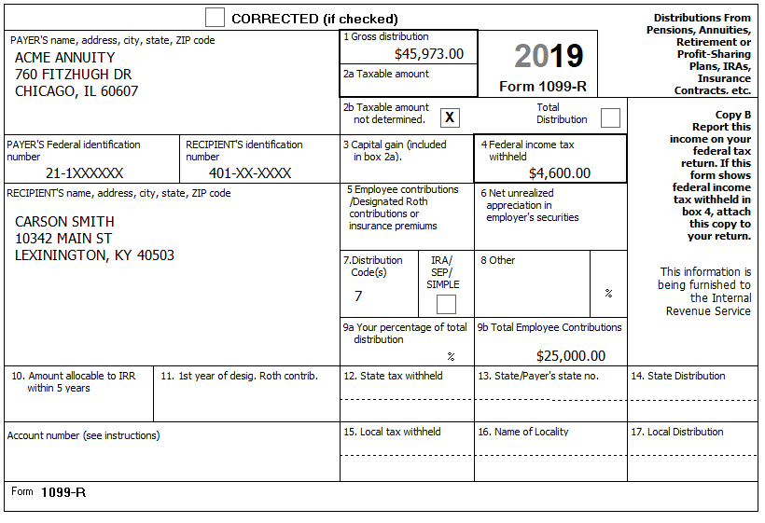
Unrecovered Annuity Example
Carson Smith (DOB 12/01/1945) began receiving an annuity on March 1, 2017. He used the simplified method to recover a portion of his employee contributions each year until his death on December 28, 2019.
This is not a survivor annuity.
Notes:
In this example, if this were a joint annuity, the joint annuitant would continue with simplified method as initiated on the annuity start date.

Slide 42
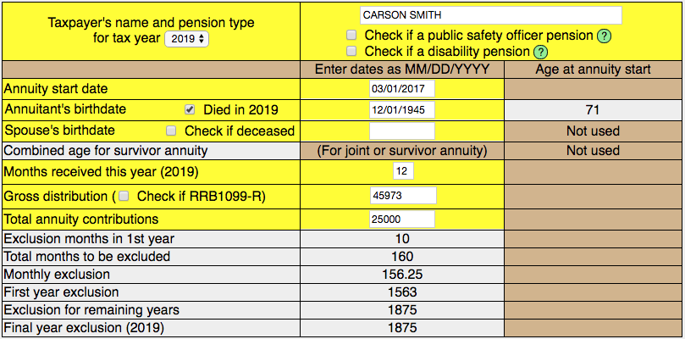
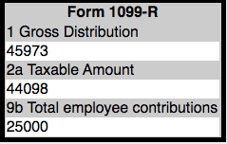
Unrecovered Annuity Example (cont.)

Slide 43
Unrecovered Annuity Example (cont.)
Carson’s 1099-R box 2a taxable amount for 2019 is $44,098
Carson has a miscellaneous itemized deduction of $19,687
Bogart calculator direction:

Slide 44
Miscellaneous Deductions (cont.)
The following miscellaneous deductions are out of scope
Repayments of income greater than $3,000
This is a scope change
Certain work-related expenses for persons with a disability
Certain Ponzi scheme losses
Certain casualties
Notes:
44

Slide 45
Quality Review
Review with taxpayer to ensure all deductions considered
Review taxpayer’s documents to ensure all deductions are entered in TaxSlayer
Compare to prior year’s deductions
Review for state adjustments

Slide 46
Summary with Taxpayer
Explain why itemizing does or does not help
Explain thresholds
Medical expenses exceeding 10% of the taxpayer’s AGI are deductible
Changes in tax law
Remind of need to keep records and receipts

Slide 47
Itemized Deductions
Questions?
Comments?
Notes:
47

Slide 48
Miscellaneous Deductions (old subject to 2% of AGI)
For State Purposes, Maybe

Slide 49
Unreimbursed Employee Expenses
Unreimbursed employee expenses
Uniforms, job hunting, union dues, etc.
Use Form 2106 for mileage at standard rate or travel
Business entertainment
Work related education (if not claimed for Lifetime Learning credit)
Special rules apply for performing artists – out of scope
Notes:
49
Clarify
Unreimbursed employee expenses are:
Ordinary and necessary expenses attributable to your job
Common and accepted in your field of trade, business, or profession
Helpful and appropriate for your business
An expense does not have to be required to be considered necessary
Example: work related education
Perhaps not eligible for Lifetime Learning credit

Slide 50
For the Production of (Taxable) Income
To produce or collect income
Investment management fees
Investment training – but not on cruise ships
Manage or maintain income-producing property
Safe deposit box holding securities
IRA trustee fee when paid outside of IRA
If paid within IRA, not deductible

Slide 51
For the Production of Income
Cost to produce or collect taxable income, example: legal fees to obtain social security benefits (e.g. survivor benefits)
Deductible to the extent the income is taxable
If 85% of social security benefit is taxable, 85% of legal fee is deductible
If none of social security benefit is taxable, none of the legal fee is deductible
Notes:
51

Slide 52
Other 2% Miscellaneous Deductions
To determine, contest, pay or claim a refund of any tax
Credit card service fee when paying tax by credit card
Repayments of previously taxed income of less than $3,000, e.g. unemployment benefits
Tax preparation fees
Loss on termination of traditional or Roth IRA
Loss on termination of annuity (where annuitant is alive)

Slide 53
Miscellaneous Deductions
Questions?
Comments?
Notes:
53

